Slide 1

Data-Driven Film Strategy for Mega-Pik
An exploratory data analysis of 500 theatrical releases to reverse recent box-office slumps and optimize catalog remake greenlighting.
Market Analytics Group
Mega-Pik Entertainment
Executive Greenlight Committee

Slide 2

Diagnosing Mega-Pik's Box-Office Slump
From Intuition to Quantitative Strategy
83%
Competitor studios experienced similar downturns but successfully rebounded by modernizing high-equity catalog remakes for new audience demographics.
Our analytics team audited 500 feature films (2010–2025) to evaluate opening velocity, budget-to-gross elasticity, and genre-specific profitability floors.
Recent Underperformance
5 of last 6 films barely broke even or lost capital
Core EDA Mandate: Re-engineer Mega-Pik's slate to maximize opening weekend capture and eliminate downside capital risk.

Slide 3

Opening Weekend vs. Lifetime Theatricals
Opening Velocity as a Pacing Metric
The 2.8x Theatrical Multiplier Baseline
A negative Opening Weekend ROI is mathematically standard in film economics—production and marketing budgets are spent upfront, while opening weekend covers only the first 72 hours.
Standard industry theatrical distribution generates 2.5x to 3.5x (mean: 2.8x) the opening weekend gross across the full theatrical lifecycle, plus downstream VOD and streaming windows.
→
Opening Share: Accounts for 25% to 40% of lifetime gross.
→
Average Production Budget: $54.8M across 500 benchmark titles.
→
Cost Recovery: Films recovering >50% of cost in opening 72h have a 92% lifetime profit probability.
→
Average Marketing Allocation: $28.2M (~51% of production spend).
→
Negative ROI Myth: -45% opening ROI represents a healthy 55% capital recoupment in 3 days.
→
Downside Trigger: Releases capturing <35% opening recovery face an 84% deficit rate.

Slide 4
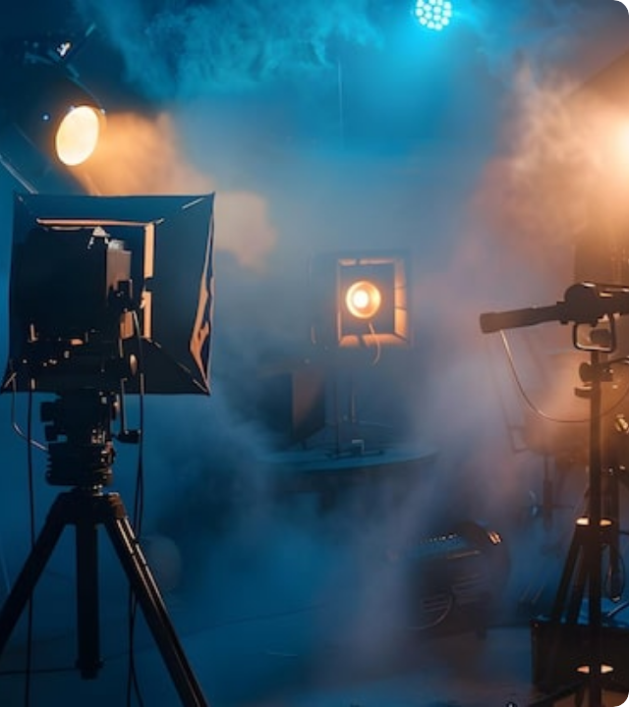




Dataset & Feature Architecture
500 Standardized Film Records
To establish rigorous benchmarks, we engineered dynamic features capturing capital investment, preview momentum, and lifetime box office returns.
Total Cost
Preview Velocity
Budget + Marketing Spend
Opening Night / Weekend %
Lifetime Box Office
Lifetime ROI %
Opening Weekend × 2.8x
Net Profit / Total Cost

Slide 5
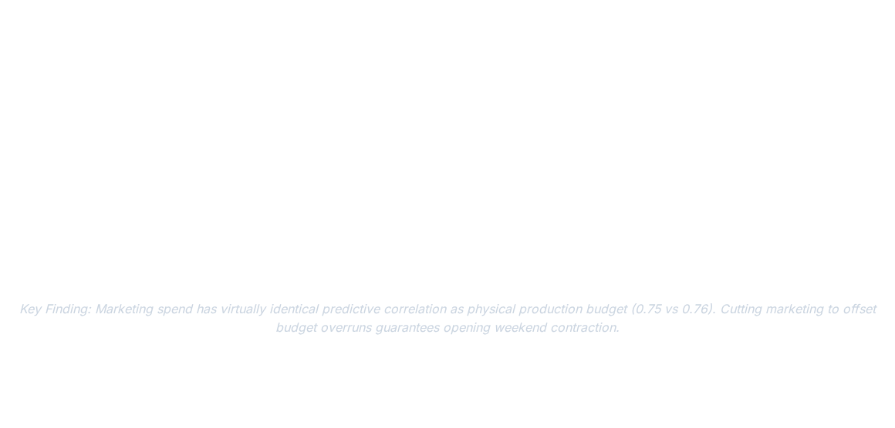

Correlation of Opening Weekend Drivers
Variable Metric | Correlation (r) | Predictive Power | Strategic Action for Mega-Pik
Opening Night Revenue | 0.99 | Deterministic | Maximize Thursday preview capacity and event screenings
Total Investment Cost | 0.77 | High Influence | Ensure production scale matches intended distribution footprint
Production Budget | 0.76 | High Influence | Cap standalone original budgets at $90M to prevent over-leverage
Marketing Spend | 0.75 | High Influence | Mandate 45%–55% marketing-to-budget ratio for all tentpoles

Slide 6
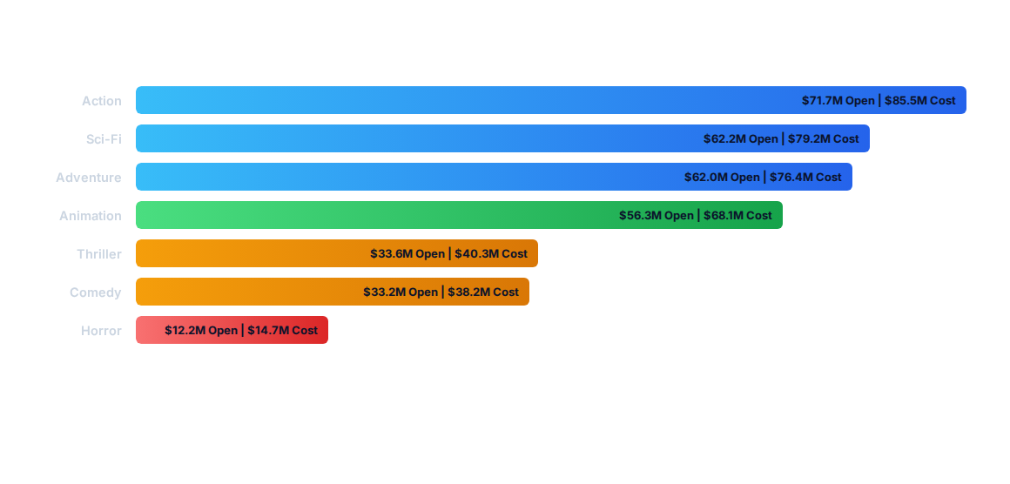
Average Cost vs. Opening Gross by Genre
Action, Sci-Fi, and Adventure lead gross volume capture ($60M–$72M openings), while Horror operates at an ultra-lean $14.7M cost floor with exceptional capital turnover.

Slide 7
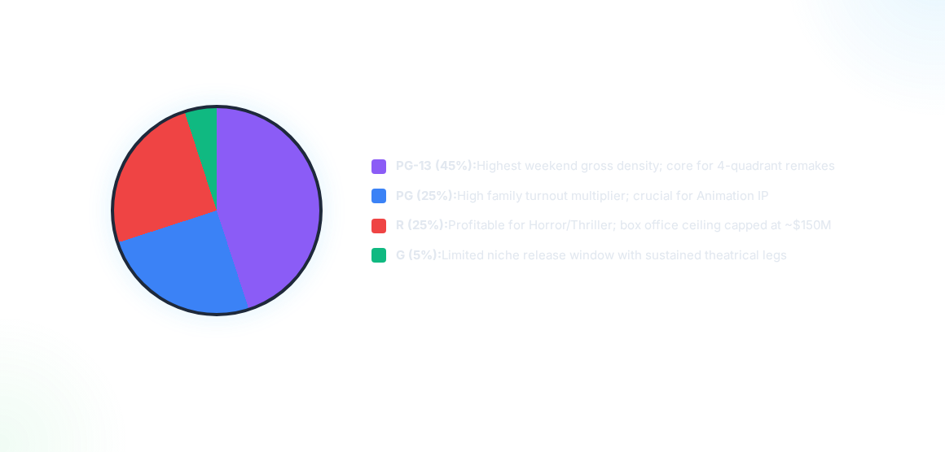
Rating Distribution & Box Office Capture
Over 80% of all $100M+ opening weekends are captured by PG-13 and PG ratings due to unrestricted demographic accessibility.

Slide 8
Genre Risk Profile & Margin Efficiency
High-Margin, Low-Risk Genres
High-Ceiling, Volatile Genres
Horror (51.6% Median ROI) & Comedy (42.0% Median ROI) deliver the studio's highest capital efficiency with minimal loss exposure.
Action (32.5% Median ROI) & Drama (19.1% Median ROI) carry substantial downside variance despite large gross numbers.
→
Action Volatility: Produces massive outlier hits (+738% max ROI), but bottom 25% of titles fail to break even (-5.0% ROI).
→
Lean Production: Average Horror cost floor under $15M.
→
High Downside Floor: 25th percentile sits at +5.9% ROI—virtually zero risk of catastrophic studio write-downs.
→
Drama Underperformance: Lowest median ROI and slowest opening momentum.
→
Animation Stability: 25th percentile at +12.2%, making family remakes the safest investment vehicle.
→
Strategic Rule: Never greenlight standalone mid-budget dramas without streaming pre-sales.

Slide 9




Mega-Pik Annual Slate Roadmap (2+4 Model)
Q2: Summer Tentpole
Q4: Holiday Animation
High-budget Action/Adventure remake ($85M–$95M, PG-13) backed by 50% marketing allocation.
Family catalog remake ($70M–$80M, PG) driving global merchandising and 4-week box office legs.
Q1: Horror Remake
Q3: Comedy / Thriller
Low-budget classic IP ($15M–$20M). High margin target to establish positive FY cash flow.
Counter-programming release ($25M–$35M) targeting adult demographic with strong digital push.

Slide 10





Executive Action Pillars for Mega-Pik
Catalog IP Selection
Marketing Allocation
Portfolio Hedging
Prioritize 1990s–2000s Animation and Adventure properties with built-in nostalgia for tentpoles, and acquire cult Horror IP for high-margin low-cost slates.
Enforce mandatory 45%–55% marketing-to-budget ratios. Deploy 60% of marketing spend prior to Thursday night previews to drive opening velocity.
Balance 2 global tentpoles ($80M+) with 4 mid/low-budget genre releases ($15M–$35M) to eliminate single-film solvency risk across the fiscal year.

Slide 11
The Strategic Greenlight Principle
“
Great studio turnarounds are built by eliminating downside risk on mid-budget titles while concentrating capital behind proven four-quadrant IP.
”
Mega-Pik Analytics Framework
Data-Driven Theatrical Optimization & Slate Portfolio Management

Slide 12






Executive EDA Visual Dashboard
1. Opening Drivers
Thursday previews (r=0.99) & Total Cost (r=0.77) dictate opening 72h velocity.
2. Rating Power
PG-13 & PG ratings capture the vast majority of $100M+ weekend openings.
3. Genre Volume
Action & Adventure drive gross box office scale ($60M–$72M opening mean).
4. Downside Floor
Horror & Animation provide near-zero capital loss risk (25th %ile > 0% ROI).

Slide 13
Questions & Discussion
Empowering Mega-Pik's Greenlight Committee with predictive box-office intelligence.
500-Film EDA Dataset
2+4 Slate Model
analytics@megapik-studio.com

Slide 14

Image Sources
https://img.magnific.com/premium-photo/cinematic-studio-setup-with-dramatic-lighting-smoky-atmosphere-professional-photography-videography-production_1335075-32683.jpg?semt=ais_hybrid&w=740&q=80
Source: www.magnific.com

